Slide 1

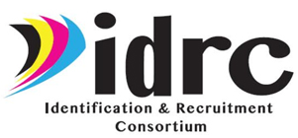
Making Your ID&R Checklist:
What Every State Should be Doing
to Build a Strong ID&R Program
Justyn Settles
IDRC Project Specialist
859-361-2239- cell
justynidr@gmail.com
www.idr-consortium.net

Slide 2
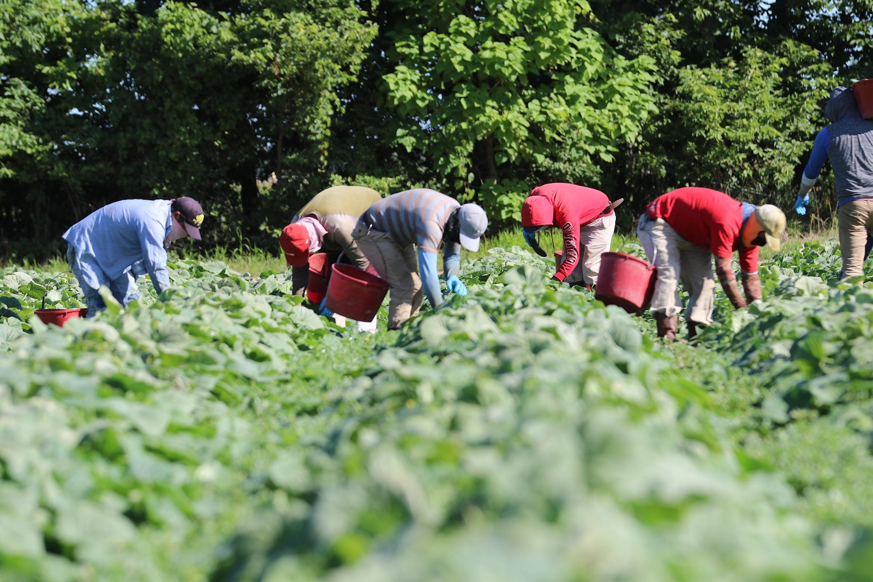
Agenda:
Today we will look at the essential practices and strategies states and recruiters can implement in the areas of Data Tracking, Quality Control, and In Field Recruitment to lay the foundations of ID&R success.

Slide 3

The Essentials of ID&R
While all states may differ in their organizational models and approach to ID&R, there are key practices and strategies that all states can adopt to ensure they meet federal requirements and give themselves the best opportunities to be successful.

Slide 4
The Essentials of ID&R
In Field Recruitment
Data Tracking
Quality Control
Your state's Data Tracking efforts, Quality Control procedures, and In Field Recruitment work together to put you in the best position to reach as many students as possible.

Slide 5
The Essentials of ID&R
All 6 required responsibilities for a state's ID&R program that OME lists in Chapter III A4 of the Non-Regulatory Guidance can be placed into the Data tracking, Quality Control, and In Field Recruitment categories.

Slide 6

Data Tracking Responsibilities
Page 36 of the MEP Non-Regulatory Guidance states that the State Educational Agencies responsibilities for ID&R are:
Data Tracking
Implement a formal process to map all of the areas within the State where migrant families are likely to reside.
Evaluate periodically the effectiveness of identification and recruitment efforts and revise procedures as needed.
Source: MEP Non Regulatory Guidance Chapter III:A4, pg. 36

Slide 7
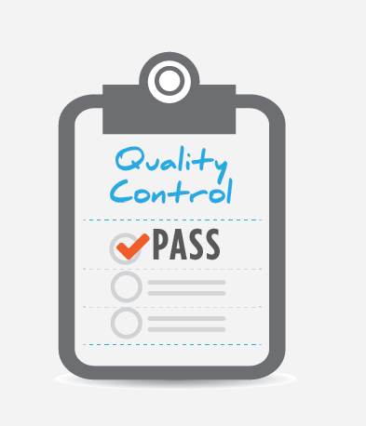
Quality Control Responsibilities
Page 36 of the MEP Non-Regulatory Guidance states that the State Educational Agencies responsibilities for ID&R are:
Quality Control
Train and guide recruiters on how to identify and recruit migrant children and how to make appropriate eligibility determinations.
Implement quality control procedures designed to ensure the reasonable accuracy of recruiters’ eligibility determinations and written eligibility documentation.
Source: MEP Non Regulatory Guidance Chapter III:A4, pg. 36

Slide 8
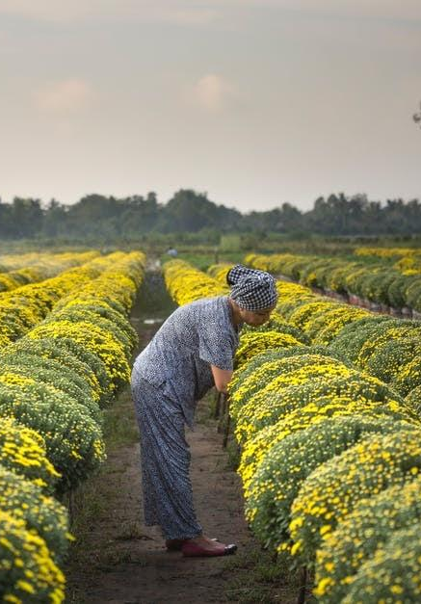
In Field Recruitment Responsibilities
Page 36 of the MEP Non-Regulatory Guidance states that the State Educational Agencies responsibilities for ID&R are:
In Field Recruitment
Develop procedures to effectively identify and recruit all eligible migrant children in the State, generally through a statewide recruitment plan.
Deploy recruiters to carry out statewide identification and recruitment efforts and monitor their efforts.
Source: MEP Non Regulatory Guidance Chapter III:A4, pg. 36

Slide 9

Why should we collect Data?
Data is crucial to fully understanding your state, understanding your program and evaluating the effectiveness of your efforts.
All Identification and Recruitment efforts should be able to be supported by data and documentation of data.
Data helps you to understand migration patterns of students entering and leaving your state
With enough data collected you can properly predict and plan how your season will go.
Data tracking helps to alleviate the negative impact of staff turnover
Data is always evolving and changing so we should always be collecting more data

Slide 10
What Data Should We Collect?
All aspects of Identification and Recruitment can be tracked using data. Key data points you should be tracking include:
Farms and Agribusinesses across the state
Potential community contacts/partners
Community locations frequently visited by migrant families
Addresses commonly used for housing
Monitoring and recording recruitment efforts
Training opportunities provided to staff
How many COEs were obtained? How many students enrolled?
Location of COEs obtained

Slide 11

Tracking Farm Data
Many states or regions currently do not systematically track farm data in their area. Having farm data is foundational to ensuring the effectiveness of your recruitment efforts:
Tracking farm data is a necessary step for creating the maps as requested by OME in the Non-regulatory Guidance
Tracking farm data makes recruiting easier
Tracking farm data helps you create and implement a recruiting plan
Tracking farm data will help you evaluate how effective your efforts are being

Slide 12
How to Track Farm Data
Regularly research your region and search for farms and agribusinesses in your area.
Download H2A available for your state to see
Create a database of locations visited by recruiters and the results of those visits.
When collecting COEs make sure you are collecting the information of the farm that the Migratory Agricultural Worker is employed

Slide 13
How to Track Farm Data
Store all information collected and gathered in an database, excel spreadsheet, or master list that is available for all Identification and Recruitment staff. This will prevent loss of information in case of staff turnover.
Keep all data for at least 5 years to help you see the bigger picture.

Slide 14

Creating Community Profiles
A Community Profile is a spreadsheet that tracks farms and other agribusinesses in your county, community contacts that might help your ID&R efforts, partner organizations, housing sites, government agricultural agencies, and other important recruiting locations you may want to track. Profiles should include:
Name of location
Address
Contact Information
Name of person to contact
How many workers they may employee
When they were last contacted
Important notes about the location

Slide 15
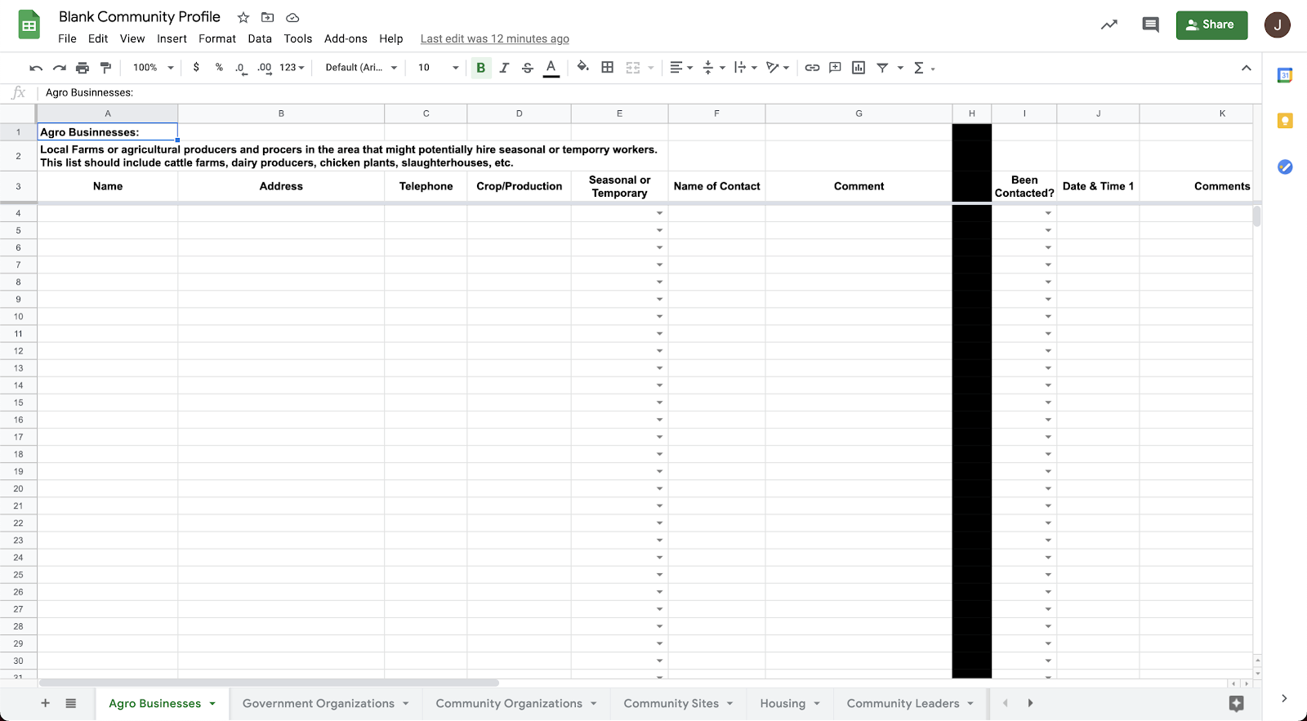
Explanation for what each tab includes
Clearly labeled columns and space to track when location was contacted
Tabs to stay organized

Slide 16

Monitoring Recruitment Efforts
Monitoring recruitment efforts is a responsibility listed in the Non-Regulatory Guidance and a critical part of OME's recommended quality control process. Monitoring recruitment efforts is not about micromanaging recruiters. Monitoring recruitment efforts is about knowing what is occurring so you can properly evaluate your program's ID&R strategy and effectiveness.
Monitoring recruitment efforts allows supervisors to provide much needed support to recruiters. When a supervisor is aware of what recruiters are doing they can provide ideas and resources that can help them be as effective as possible.

Slide 17
Monitoring Recruitment Efforts
Individual recruiters can always monitor their own efforts to evaluate how they are doing and reassess their strategies.

Slide 18
Monitoring Recruitment Efforts
Gather information about what locations recruiters are visiting
What types of activities are recruiters doing?
  How much time is spent planning?
  How much time is spent training?
  How much time is spent following up on referrals from the school?
  How much time is spent visiting agribusinesses compared to families and housing sites?
Collect the information from all recruiters to see how current recruitment efforts match your state's identification and recruitment plan
Keep a record of common mistakes committed by recruiters, on COEs, and found during the re-interview process

Slide 19

Evaluating Recruitment Efforts
The most common error committed by identification and recruitment staff across the country are staff becoming too comfortable in their knowledge and their recruitment efforts. Many experiences recruiters are hesitant to try new things because their strategies have been successful in the past.

Slide 20
Evaluating Recruitment Efforts
There is always room to improve your strategy. It is necessary to regularly a step back, look at what is being done, research what is out there, compare current data with previous data, and re-evaluate what is being done. If your state has a period during the year where things slow down, it is the perfect time to evaluate and assess your strategy.

Slide 21
The Continuous Cycle of Improvement
Planning/Strategizing
Evaluation/Assessment
Acting/Implementation
Collection of Data

Slide 22

How to Evaluate Your Efforts
When you are taking the time to evaluate and assess ask yourself the following questions:
What story does your data tell?
Is there anything in the data that surprises you?
How does your data compare to previous years?
If there are major differences, what can account for the changes?
What can you learn from looking at the data?
Are there gaps that you can see in the data?
Are there any areas where you believe you can improve?

Slide 23
Evaluating Recruitment Efforts
A key part of the evaluation process is to research your area and talk to people working in the agricultural industry or agricultural agencies in your region.
Are there any updates or trends that could explain a change in the number of migrant students in the area?
Are there any upcoming changes to the industry that could affect the future number of migrant students in the area?
Are you able to confirm some of the rumors you were hearing from families or students?

Slide 24
Assessing Your Plan/Strategy
After looking at the data see how the data compares to the ID&R plan you had originally set.
Does the data support your original plan/strategy?
Go through your goals and assign a grade of 1 to 5 based on how well you accomplished them.
Where the goals you set realistic?
What goals can you set for the following year?
Look for new areas or demographics to explore.
  Are you finding new groups of students?
  Are there new crops you can add to your plan?
Does your ID&R plan cover your entire state/region?

Slide 25

The Importance of Quality Control
Quality control is a crucial and required step in the Identification and Recruitment process. Quality Control ensures the correct eligibility decisions are being made and that the data you are collecting is correct. OME outlines their recommendations for Quality Control in the Non-Regulatory Guidance.

Slide 26
Quality Control Requirements
Page 39 of the MEP Non-Regulatory Guidance defines an acceptable system of Quality Control as containing the following elements:
Training for recruiters on various aspects of the job;
A designated reviewer for each COE to verify that, based on the recorded data, the child is eligible for MEP services;
A formal process for resolving eligibility questions raised by recruiters and their supervisors and for transmitting responses to all local operating agencies in written form;
A process for the SEA to validate that eligibility determinations were properly made;
Source: MEP Non Regulatory Guidance Chapter III:A13, pg. 39

Slide 27
Quality Control Requirements
Page 39 of the MEP Non-Regulatory Guidance defines an acceptable system of Quality Control as containing the following elements:
Apart from steps 2 and 4, a plan for qualified SEA staff to monitor, at least annually, the identification and recruitment practices of individual recruiters;
Documentation that supports the SEA's implementation of this quality control system and a record of actions taken to improve the system where periodic reviews and evaluations indicate a need to do so;
A process for implementing corrective action in response to internal audit findings and recommendations.
Source: MEP Non Regulatory Guidance Chapter III:A13, pg. 39

Slide 28

Re-interviews and Speaking to Families
Annual re-interviews are crucial to the Quality Control process to ensure that correct eligibility decisions are being made and to give insight into the perception of the program from families enrolled in the program.
We recommend re-interviewing 1 out of every 10 COEs
The re-interview results can uncover common mistakes made by recruiters and how families feel about the program
During the re-interview process ask families their perception of the program, the recruiting process, and services received
  Families enrolled in the program should be our best advocates and can help spread the word to new families
Properly document the re-interview process including recommended steps to correct any issues found

Slide 29

Establishing a Training Plan
Recruiter training is a key part of quality control. There are many different regulations that govern eligibility and recruiters are not using all of them all of the time. Recruiting skills are like any other skill in that if they are not being used regularly, they can get forgotten. Regular training ensures that recruiters are always operating at maximum capacity and means less work for supervisors in the long term.

Slide 30
How to Establish a Training Plan
The first step is prioritizing training for recruiters
Establish an onboarding protocol that guarantees new ID&R staff will have the required knowledge to be successful
Annually assess recruiter knowledge using practice scenarios to gauge gaps in their training and knowledge
Recruiters should regularly read and reread the guidance
Look at the data you collect from recruiters and use the data to identify where training is needed
  What recruiting/eligibility rules are used the most?
  What recruiting/eligibility rules are used the least?
  What are the common mistakes made by recruiters and found on COEs and in re-interviews?

Slide 31
How to Establish a Training Plan
Bring ID&R staff into the training process
  Have ID&R staff chose a topic they are comfortable with and create a training they can give to other staff
  Assign portions of the Non-Regulatory Guidance or OME National Recruiting Manual and have ID&R staff teach other staff on their assigned portions
  Encourage ID&R staff to recruit in the field together at least once a quarter to learn from one another
Establish and document your process for answering ID&R questions to incorporate into your training process
Evaluate every year your training plan and use data to see how effective your training plan has been

Slide 32
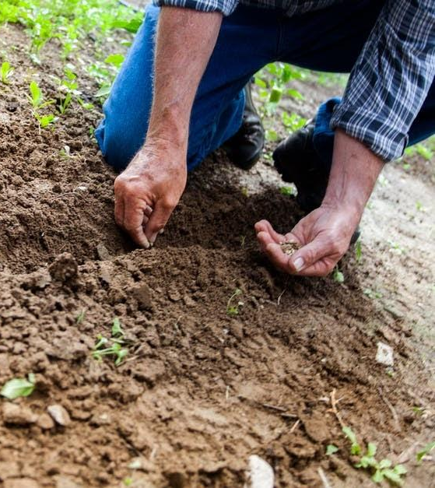
In Field Recruitment
Many experienced recruiters often fall into the trap of regularly returning to the same places year after year. To maximize ID&R efforts recruiters should strive to be as thorough as possible, always look for new leads, and to make sure they are visiting a wide variety of locations.

Slide 33

Establish a Recruiting Plan
A key tool in guaranteeing recruiters are being thorough and diversifying their efforts is to establish a strong ID&R for the state/region.

Slide 34
An ID&R Plan Should Include...
The ID&R plan should include all activities the state/recruiter hopes to accomplish throughout the year
The ID&R plan should establish clear goals that are realistic and measurable
The ID&R plan should highlight critical Dates/seasons
  When are key crops in season?
  When do H2A workers arrive?
  Are there any festivals or events tied to local agricultural work that could be good recruiting leads?
  When should key activities be done during the year?
  When are there times to try new things?
Recruiters should use their plan to dream big and be creative

Slide 35
Making a Well Rounded ID&R Plan
Make sure your ID&R Plan is well rounded and includes diverse strategies and locations.
Are you spending sufficient time recruiting field?
Are you working with schools to recruit new students?
Are you working with local organizations that might work with similar populations?
Are you visiting farms and looking up H2A work orders?
Are you visiting both temporary and seasonal agribusinesses?
Are you reaching out to dairies, meat, and poultry processing plants?
Are you reaching out to local agricultural agencies?
Always look for new areas to explore.

Slide 36

Agricultural Extension Offices
Do you work with your Ag Extension Agents to participate in trainings they offer for farmers? Many of these are now virtual trainings.
Do you have a relationship on the state level with their state offices?
It can be helpful to survey extension agents for specific information such as latest agricultural information, trainings you could participate in, ideas on how to work with growers, specific ideas they you can partner with them, etc.
https://nifa.usda.gov/land-grant-colleges-and-universities-partner-website-directory?state=All&type=Extension

Slide 37

USDA Local Food Directories
https://www.usda.gov/media/blog/2014/09/30/easy-way-find-local-food-usda-launches-new-local-food-directories
The USDA runs several programs that help connect communities with fresh organic produce and to support local farms. Directories run by the USDA include:
Community Supported Agriculture database - List and map of farms that offer consumers regular deliveries of locally-grown farm products during harvest season on a subscription or membership basis.
National Food Hub Directory - A Food Hub is a business that actively manages the aggregation, distribution, and marketing of food products to multiple buyers
National On-Farm Market Directory - List and map of farms that offer on-site markets that sell agricultural products directly to consumers
National Farmers Market Directory - List and map of markets that feature two or more farm vendors selling agricultural products directly to customers

Slide 38

Continue Researching Your Area
Pay attention to what is happening in each community
Google news alerts can help you track agricultural news:
https://www.google.com/alerts
Make strong connections with local school staff as they often have direct ties or know someone who works in local farms/agribusinesses
Find your local farm labor contractors:
https://www.dol.gov/agencies/whd/agriculture/mspa/farm-labor-contractors
Visit local the USDA Meat, Poultry, and Egg Processors
https://www.fsis.usda.gov/wps/portal/fsis/topics/inspection/mpi-directory

Slide 39
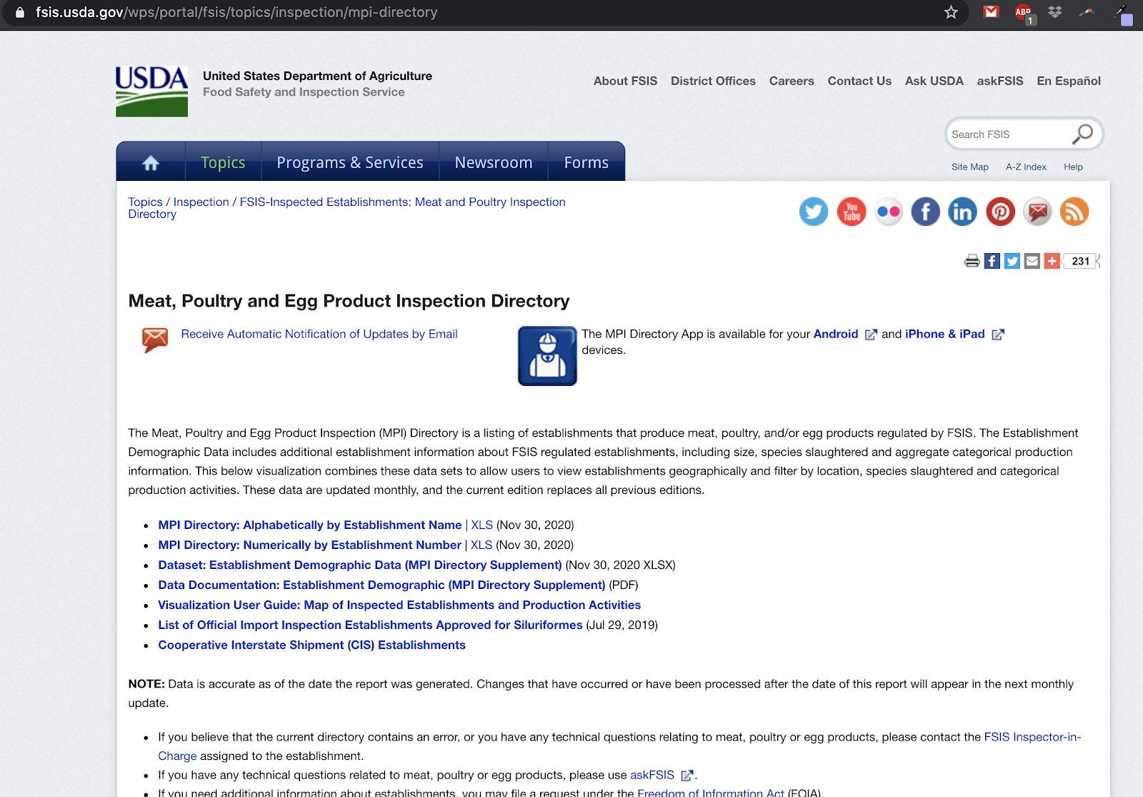
USDA Meat, Poultry, and Egg Processor List
The US Department of Labor maintains a list of all meat, poultry and egg Processors
Download a spreadsheet of the meat, poultry and egg Processors by clicking on this link
The spreadsheet can be sorted and searched by state so you can find all processors in your area.

Slide 40
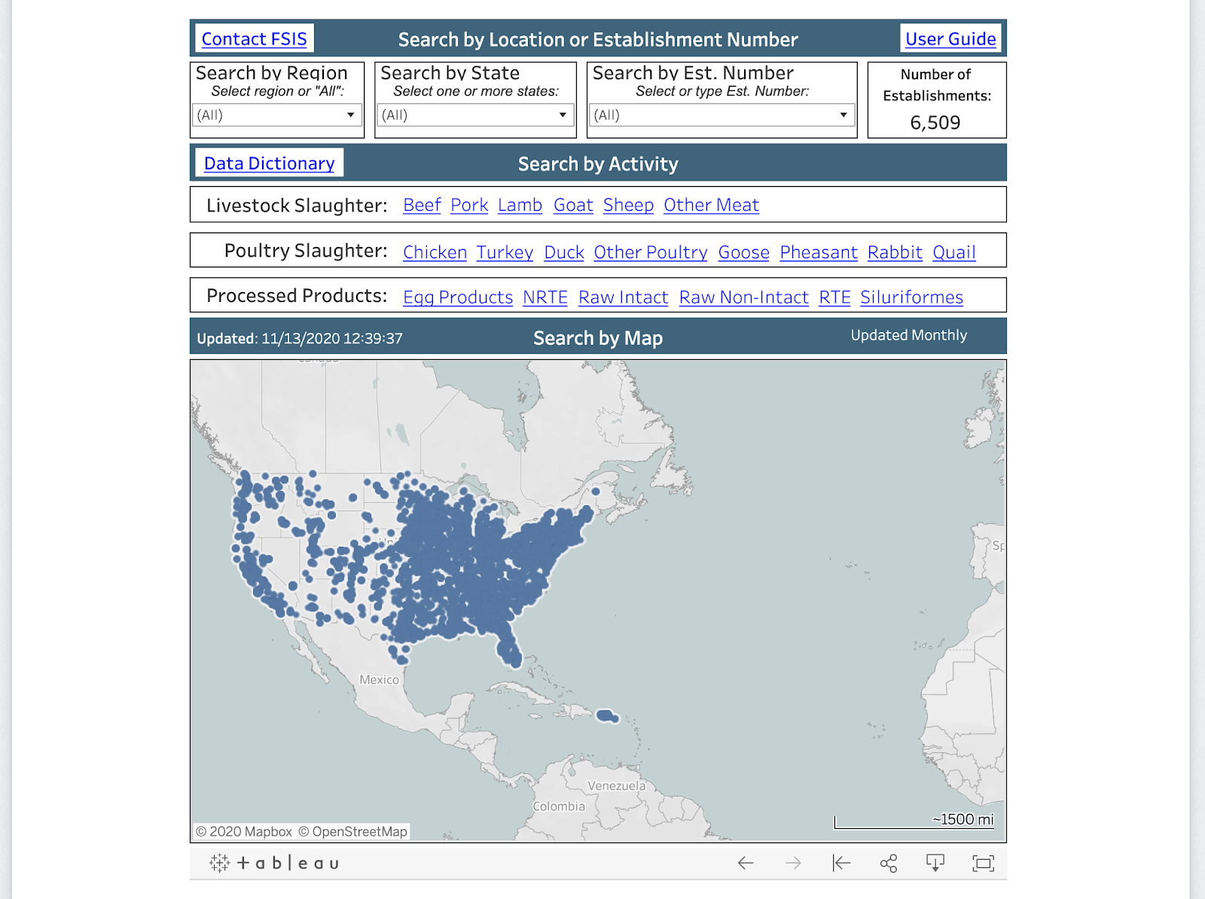
USDA Meat, Poultry, and Egg Processor List
If you scroll down on the US Department of Labor website you will see a searchable map of all meat, poultry, and egg processors.
Below the map is a searchable table where you can search your state or zip code to find the processors in your area.

Slide 41

Build a Network of Community Partners
Often times there are local agencies working with local farms/agricultural businesses or similar populations. Reach out and see about partnering up or if they can introduce you to their contacts.
Partnering agencies can help connect you to local farms and families
Rural Health Information Hub - Provides information on local health services, health focused events happening in your area, and links to local health services you can share with agribusinesses and students.
https://www.ruralhealthinfo.org/states/
National Farm to School Program - The USDA works in all 50 states that aims to increases access to local food and nutrition education to improve children’s health, strengthen family farms, and cultivate vibrant communities.
http://www.farmtoschool.org/

Slide 42
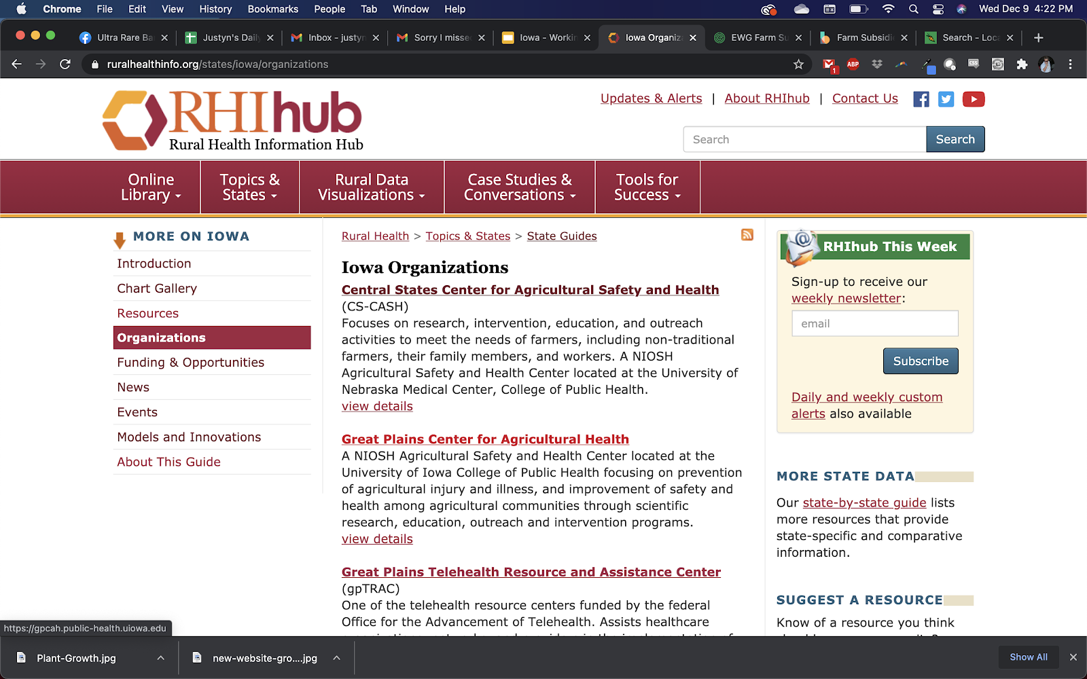
Rural Health
Clicking on the organization button on Rural Health Info's website will show you a list of local organizations working to improve health in your state. Many of the organizations work with agribusinesses. They could be great resources for local farmers and provide opportunities to build partnerships in your area.

Slide 43

IDRC Premade COVID Supply Bags
A great resource available for IDRC member states during the COVID-19 pandemic are IDRC's premade COVID-19 supply bags. The bags can be obtained from IDRC's website. All bags include:
Supersized- 27" bandana
Regular Size- 22" bandana
Facemask- N95 when available
Large bar of soap with soap box
Packet of sun screen or small hand sanitizer depending on availability.
Washable high quality garden type gloves
Printed Card in English and Spanish about how to protect yourself from COVID-19 and educational resources that are free and available online for families and youth to use.
Information on ordering IDRC COVID-19 bags can be found here:
https://www.idr-consortium.net/COVID-19%20Bags.html

Slide 44
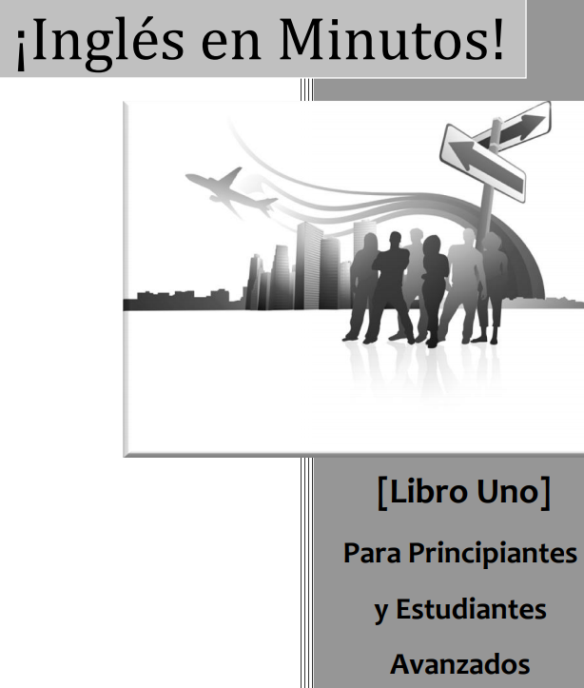
Resources to Increase Recruitment
IDRC states can request COVID PPE supply bags and English in Minutes books right now for free (someone from the state leadership (state director or IDR Coordinator has to make the request). All requests are reviewed and approved if they can show they will be using them to start a new IDR effort that will help increase access to a new population or new industry etc. They have to be willing to track these efforts and show those with us
Information on ordering IDRC COVID-19 bags can be found here:
https://www.idr-consortium.net/COVID-19%20Bags.html
EIM books can be found here: https://www.idr-consortium.net/LanguageResources.html

Slide 45

New IDRC Scenario Newsletter
A New IDRC Newsletter will be debuting soon! Beginning February 1st receive new practice scenarios and answers directly to your email once a month!
Sign up here https://www.idr-consortium.net/Newsletter.html

Slide 46
Next Monthly Webinar!
The next IDRC monthly webinar will be held:
February 16th, 2020
2:00 P.M. EST, 1:00 P.M. CST, 12:00 P.M. MST, 11:00 A.M. PST
Topic:
Developing a Daily Recruiting Plan and S.M.A.R.T. Goals

Slide 47

Training Review:
Please fill out the IDRC Training review form by using the link below or the scanning the QR code with the phone's camera
Training title:
What Every State Should be Doing
to Build a Strong ID&R Program
https://www.surveymonkey.com/r/IDRCStaffTrainingEval20-21

Slide 48


Contact Info
Jessica Castañeda
IDRC Director
931-668-4129- office
931-273-4050- cell
jcastanedaidr@gmail.com
www.idr-consortium.net
Justyn Settles
IDRC Project Specialist
859-361-2239- cell
justynidr@gmail.com
www.idr-consortium.net

